Slide 1
Applied Machine Learning SEZG568/SSZG568
Dr Y V K RAVI KUMAR
yvk.ravikumar@pilani.bits-pilani.ac.in

Slide 2
Session 4(19th August,2023)

Slide 3
Session 4 – 19th August,2023
3 | Topics from previous session - continuation

Slide 4
Model Evaluation – Confusion Matrix
The confusion matrix is a useful tool for analyzing how well the classifier can recognize tuples of different classes
For two classes, a confusion matrix is a 2 by 2 table
TP and TN - Tell us when the classifier is getting things right
FP and FN - Tell us when the classifier is getting things wrong (i.e., mislabeling)
P is the number of tuples that are actually positive
N is the number of tuples that are actually negative
P' is the number of tuples that are predicted as positive (TP + FP)
N' is the number of tuples that are predicted as negative (TN + FN)
The total number of tuples
TP + TN + FP + TN = P + N = P' + N'
 |  | Predicted class |  | Total
 |  | Yes | No
Actual class | Yes | TP | FN | P
 | No | FP | TN | N
 |  | P' | N'

Slide 5
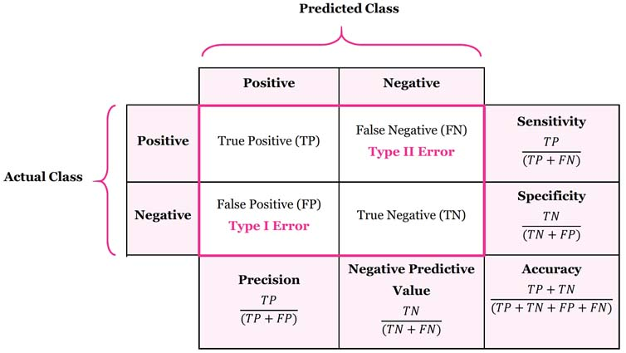
Model Evaluation – Confusion Matrix
Image: https://manisha-sirsat.blogspot.com/2019/04/confusion-matrix.html

Slide 6
Model Evaluation – Misclassification Error
1’s correctly classified as "1" = 201
1’s incorrectly classified as "0" = 85
0’s incorrectly classified as "1" = 25
0’s correctly classified as "0" = 2689
Misclassification
Error: classifying a record as belonging to one class when it belongs to another class
Error rate: percent of misclassified records out of the total records in the validation data

Slide 7
Model Evaluation – Cost Matrix
 | PREDICTED CLASS
ACTUAL CLASS | C(i | j) | Class=Yes | Class=No
 | Class=Yes | C(Yes|Yes) | C(No|Yes)
 | Class=No | C(Yes|No) | C(No|No)
C( i | j ): Cost of misclassifying class j example as class i

Slide 8
Model Evaluation – Computing cost of Classification
Model M₁ | PREDICTED CLASS
ACTUAL CLASS |  | + | -
 | + | 150 | 40
 | - | 60 | 250
Accuracy = 80%
Cost = 3910
Cost Matrix | PREDICTED CLASS
ACTUAL CLASS | C(i|j) | + | -
 | + | -1 | 100
 | - | 1 | 0
Model M₂ | PREDICTED CLASS
ACTUAL CLASS |  | + | -
 | + | 250 | 45
 | - | 5 | 200
Accuracy = 90%
Cost = 4255

Slide 9
Model Evaluation – Class Imbalance Problem
The class imbalance problem occurs when the main class of interest is rare
Examples:
Fraud detection applications
the class of interest (or positive class) is "fraud" occurs much less frequently than the negative "non-fraudulant" class
Medical data
rare class, such as "cancer"
suppose that we have trained a classifier to classify medical data tuples
Cancer = "Yes" or Cancer = "No"

Slide 10
Model Evaluation – Class Imbalance Problem
Accuracy rate of, say, 97%
may make the classifier seem quite accurate
what if only, say, 3% of the training tuples are actually cancer?
Here, an accuracy rate of 97% may not be acceptable, because
the classifier could be correctly labeling only the non-cancer tuples and misclassifying all the cancer tuples
In this case we need other measures, which assess how well the classifier can recognize the positive tuples (cancer = yes) and negative tuples (cancer = no)

Slide 11
Model Evaluation – Class Imbalance Problem
The class imbalance problem occurs when the main class of interest is rare
Examples:
Fraud detection applications
the class of interest (or positive class) is "fraud" occurs much less frequently than the negative "non-fraudulant" class
Medical data
rare class, such as "cancer"
suppose that we have trained a classifier to classify medical data tuples
Cancer = "Yes" or Cancer = "No"
Accuracy rate of, say, 97%
may make the classifier seem quite accurate
what if only, say, 3% of the training tuples are actually cancer?
Source: Data Mining Concepts & Techniques by Han, Kamber, & Pei

Slide 12
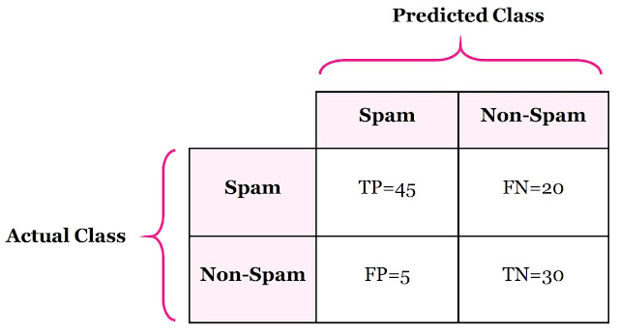
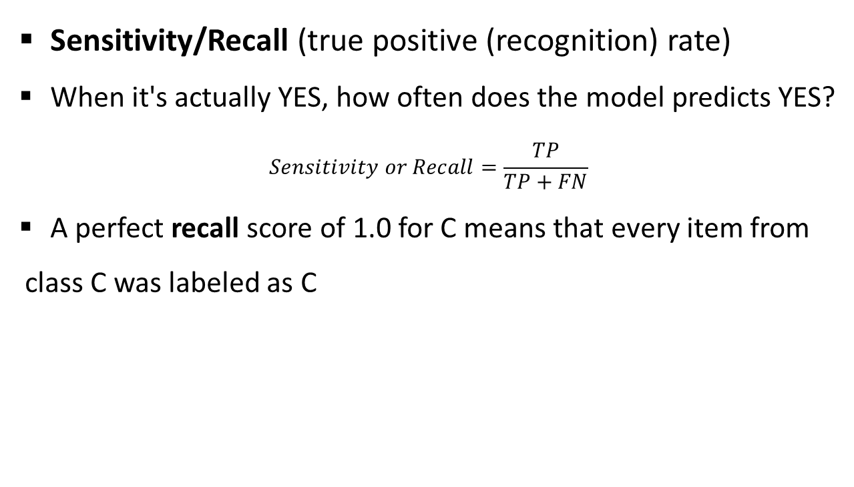
Model Evaluation – Class Imbalance Problem
 |  | Predicted class |  | Total
 |  | Yes | No
Actual class | Yes | TP | FN | P
 | No | FP | TN | N
 |  | P' | N'
Sensitivity/Recall (true positive (recognition) rate)
When it's actually YES, how often does the model predicts YES?
$$Sensitivity or Recall=\frac{TP}{TP+FN}$$
A perfect recall score of 1.0 for C means that every item from class C was labeled as C

Slide 13
Model Evaluation – Class Imbalance Problem
 |  | Predicted class |  | Total
 |  | Yes | No
Actual class | Yes | TP | FN | P
 | No | FP | TN | N
 |  | P' | N'
Sensitivity/Recall (true positive (recognition) rate)
Important when:
Identifying true positives is crucial
Used when:
The occurrence of false negatives is unacceptable/intolerable
We can rather have some extra false positives (false alarms) over saving some false negatives
E.g., when predicting deadly disease (cancer) or financial default

Slide 14
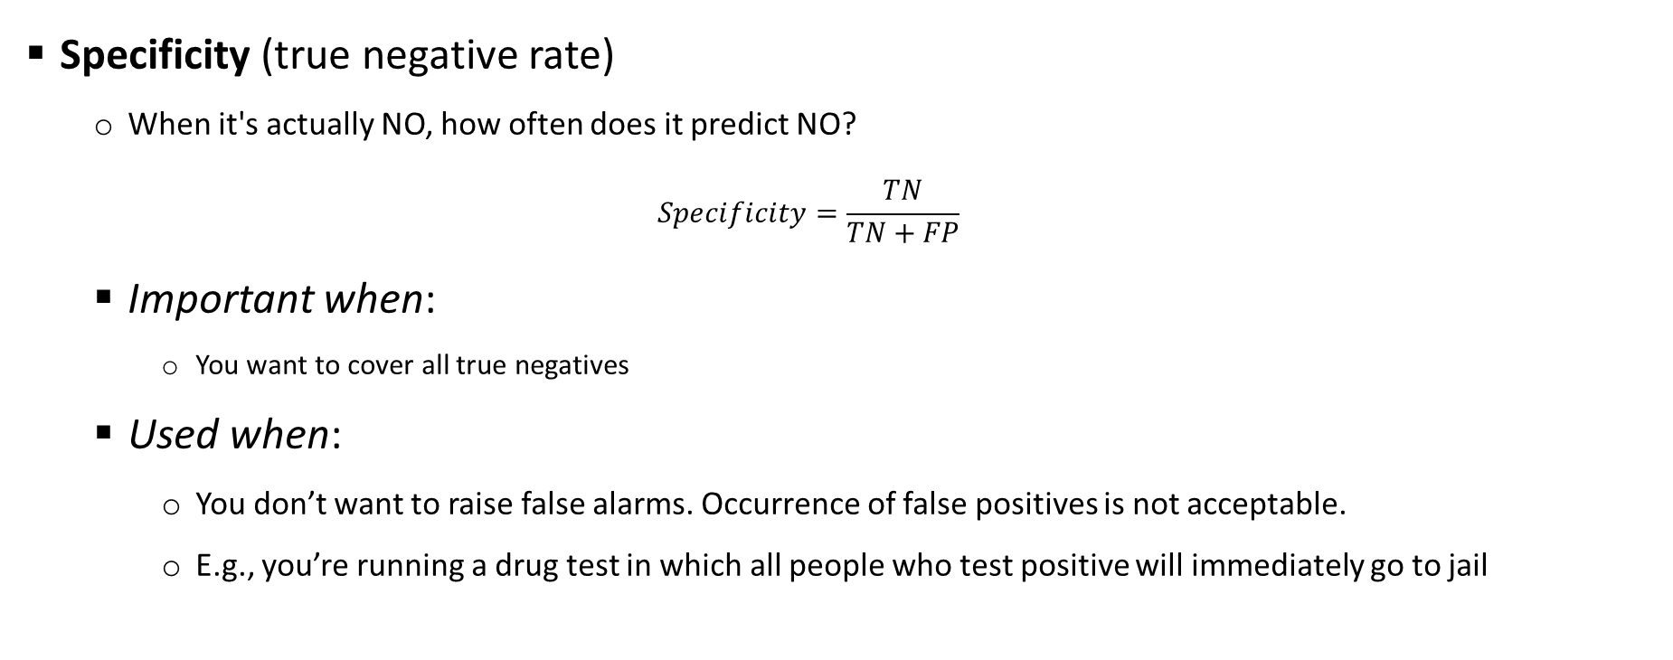
Model Evaluation – Class Imbalance Problem
Specificity (true negative rate)
When it's actually NO, how often does it predict NO?
$$Specificity=\frac{TN}{TN+FP}$$
Important when:
You want to cover all true negatives
Used when:
You don’t want to raise false alarms. Occurrence of false positives is not acceptable.
E.g., you’re running a drug test in which all people who test positive will immediately go to jail

Slide 15
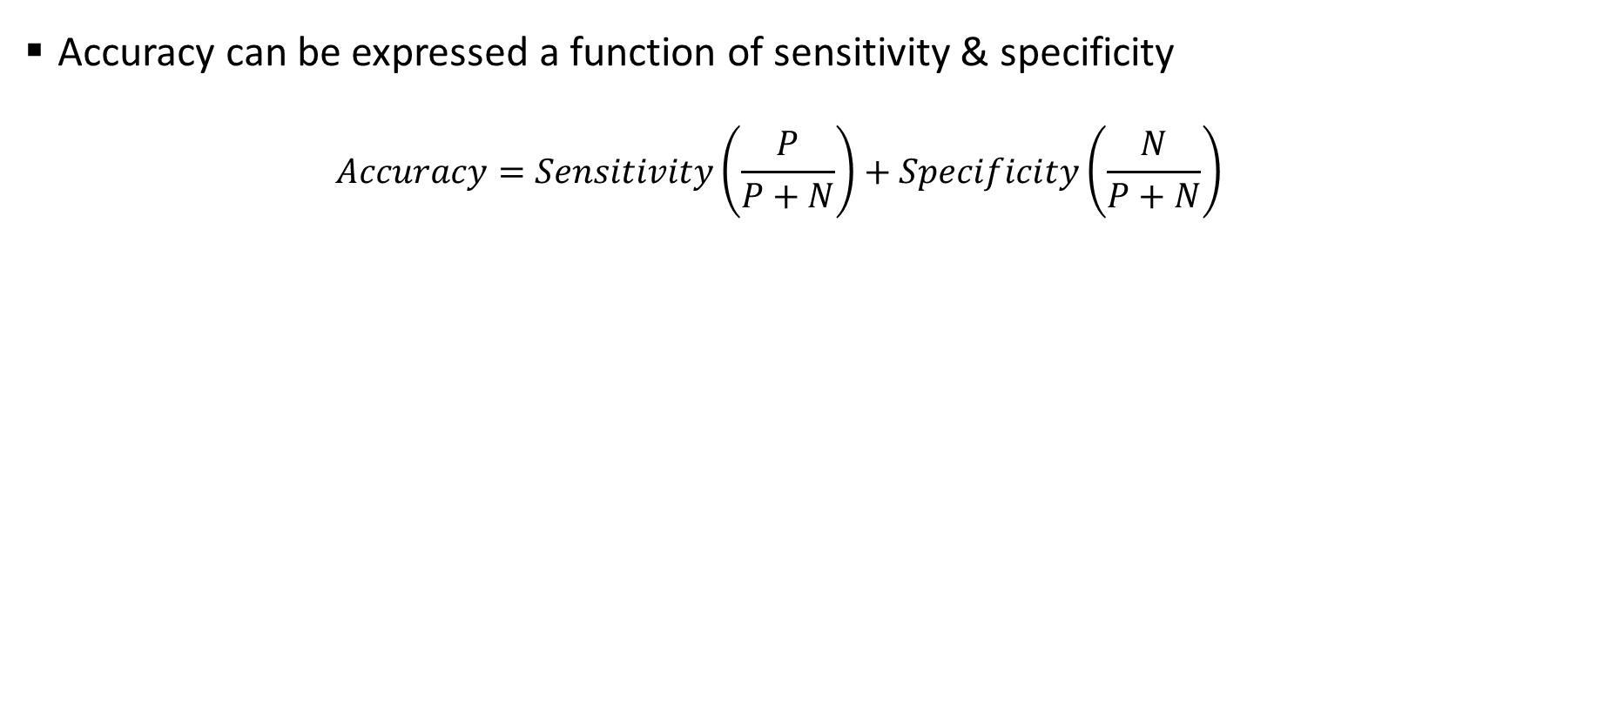
Model Evaluation – Class Imbalance Problem
Accuracy can be expressed a function of sensitivity & specificity
$$Accuracy=Sensitivity\left(\frac{P}{P+N}\right)+Specificity\left(\frac{N}{P+N}\right)$$
 |  | Predicted class |  | Total
 |  | Yes | No
Actual class | Yes | TP | FN | P
 | No | FP | TN | N
 |  | P' | N'

Slide 16
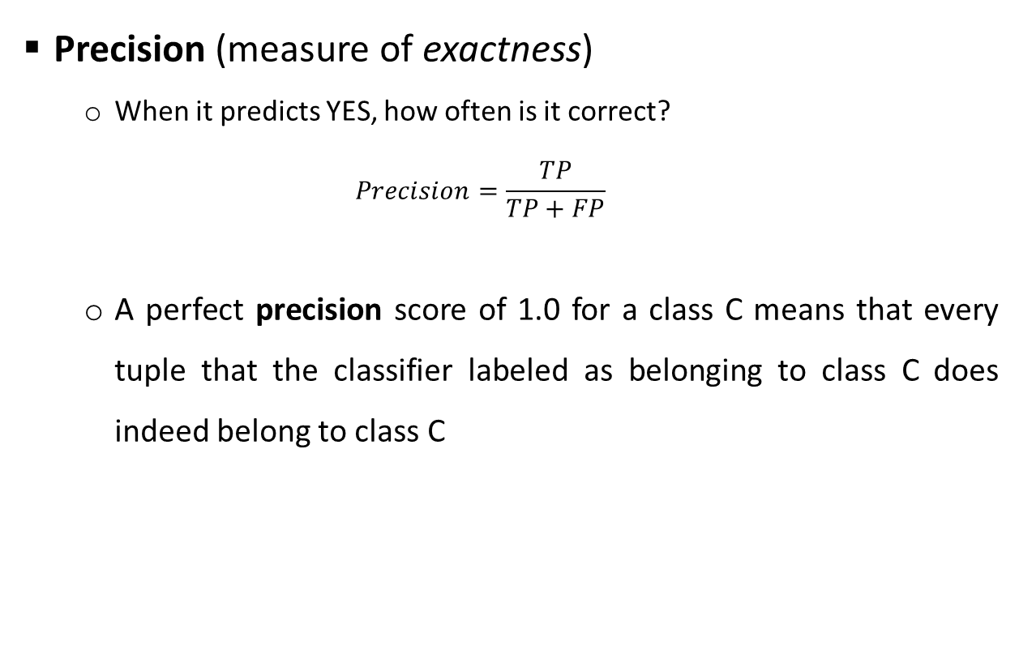
Model Evaluation – Class Imbalance Problem
Precision (measure of exactness)
When it predicts YES, how often is it correct?
$$Precision=\frac{TP}{TP+FP}$$
A perfect precision score of 1.0 for a class C means that every tuple that the classifier labeled as belonging to class C does indeed belong to class C
 |  | Predicted class |  | Total
 |  | Yes | No
Actual class | Yes | TP | FN | P
 | No | FP | TN | N
 |  | P' | N'

Slide 17
Model Evaluation – Class Imbalance Problem
Precision (measure of exactness)
Important when:
you want to be more confident of your predicted positives.
Used when:
the occurrence of false positives is unacceptable/intolerable
For example, Spam emails
We would rather have some spam emails in your inbox than miss out some regular emails that were incorrectly sent to your spam box.
Image: https://manisha-sirsat.blogspot.com/2019/04/confusion-matrix.html
Source: Data Mining Concepts & Techniques by Han, Kamber, & Pei

Slide 18
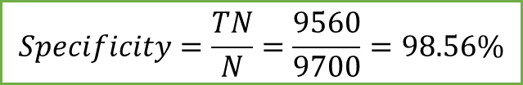
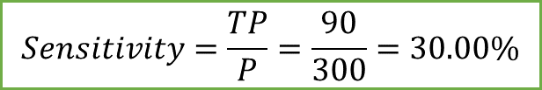
Model Evaluation – Class Imbalance Problem
Classes | Predicted class |  | Total | Recognition (%)
Actual class ⇓ | Yes | No
Yes | 90 | 210 | 300 | 30.00 (Sensitivity)
No | 140 | 9560 | 9700 | 98.56 (Specificity)
Total | 230 | 9770 | 10000 | 96.50 (Accuracy)
 |  | Predicted class |  | Total
 |  | Yes | No
Actual class | Yes | TP | FN | P
 | No | FP | TN | N
 |  | P' | N'
Confusion matrix for the classes cancer = yes and cancer = no
$$Sensitivity=\frac{TP}{P}=\frac{90}{300}=30.00\%$$
$$Specificity=\frac{TN}{N}=\frac{9560}{9700}=98.56\%$$
$$Overall Accuracy=30.00 ×\left(\frac{300}{10000}\right)+98.56 ×\left(\frac{9700}{10000}\right)=0.9+95.60=96.50$$
Source: Data Mining Concepts & Techniques by Han, Kamber, & Pei

Slide 19
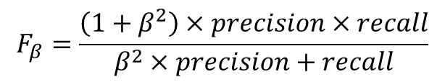
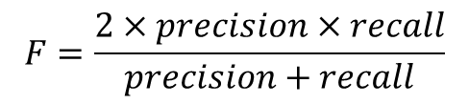
Model Evaluation – F Measure
F measure and F_{β} measure
An alternative way to use precision and recall is to combine them into a single measure
This is the approach of the F measure (also known as the F₁ score or F-score) and F_{β} measure
The F measure is the harmonic mean of precision and recall. It gives equal weight to precision and recall
Where
β is a non-negative real number
The F_{β} measure is a weighted measure of precision and recall. It assigns β times as much weight to recall as to precision
Commonly used F_{β} measures are:
F₂ (weights recall twice as much as precision) (False negative has more impart than false positive, choose a beta value greater than 1)
F_{0.5} (weights precision twice as much as recall) (False positive has more impact than false negative, you reduce beta value between 1 & 0)
$$F=\frac{2×precision×recall}{precision+recall}$$
$$F_{β}=\frac{\left(1+β^{2}\right)×precision×recall}{β^{2}×precision+recall}$$
Source: Data Mining Concepts & Techniques by Han, Kamber, & Pei

Slide 20
Model Evaluation
F measure and F_{β} measure
Important when:
you have an uneven class distribution.
Used when:
the cost of false positives and false negatives are different
F1 score
Is higher if there is a balance between Precision and Recall
F1 Score isn’t so high if one of these measures, Precision or Recall, is improved at the expense of the other.
Each one of these is defined in such a way that they capture different aspects of a model’s performance
When we are choosing one of these metrics to improve our model on, we need to keep in mind:
The problem that we are trying to solve
The dataset that we have with us (prevalence of each class in the data)
The cost that we have to pay for either types of misclassifications (false positives and false negatives)
Source: Data Mining Concepts & Techniques by Han, Kamber, & Pei

Slide 21
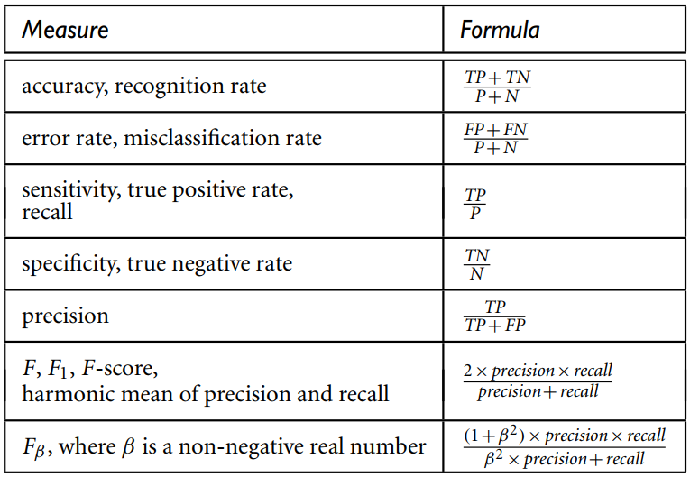
Model Evaluation - Summary
Two cases
The class tuples are more or less evenly distributed
Classes are unbalanced (e.g., where an important class of interest is rare such as in medical tests)
The classifier evaluation measures:
Accuracy (also known as recognition rate)
Sensitivity (or recall)
Specificity
Precision
F₁
F_{β}
Source: Data Mining Concepts & Techniques by Han, Kamber, & Pei

Slide 22
Methods of Evaluation

Slide 23
Methods of Evaluation – Data Selection Tech.
Holdout Method
In this method, given data are randomly partitioned into two independent sets:
Training set (2/3 of data) for model construction
Test set (1/3 of data) for accuracy estimation
The estimate is pessimistic because only a portion of the initial data is used to derive the model
Random subsampling
A variation of the holdout method
Here, the holdout method is repeated k times
The overall accuracy = average of accuracies obtained from each iteration

Slide 24
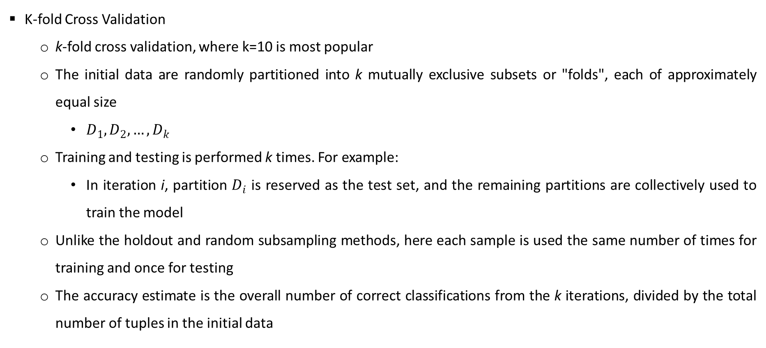
Methods of Evaluation - Data Selection Tech.
Data Selection Techniques
K-fold Cross Validation
k-fold cross validation, where k=10 is most popular
The initial data are randomly partitioned into k mutually exclusive subsets or "folds", each of approximately equal size
$D_{1},D_{2},…,D_{k}$
Training and testing is performed k times. For example:
In iteration i, partition $D_{i}$ is reserved as the test set, and the remaining partitions are collectively used to train the model
Unlike the holdout and random subsampling methods, here each sample is used the same number of times for training and once for testing
The accuracy estimate is the overall number of correct classifications from the k iterations, divided by the total number of tuples in the initial data

Slide 25
Methods of Evaluation - Data Selection Tech.
Data Selection Techniques
Cross Validation
Leave-one-out
A special case of k-fold cross-validation where k is set to the number of initial tuples
That is, only one sample is "left out" at a time for the test set
Stratified cross-validation
The folds are stratified so that the class distribution of the tuples in each fold is approximately the same as that in the initial data
In general, stratified 10-fold cross-validation is recommended for estimating accuracy
due to its relatively low bias and variance
Source: Data Mining Concepts & Techniques by Han, Kamber, & Pei

Slide 26
Methods of Evaluation - Data Selection Tech.
Data Selection Techniques
Bootstrap
Samples the given training tuples uniformly with replacement
Commonly used bootstrap method is the .632 bootstrap
On average, 63.2% of the original data tuples will end up in the bootstrap sample, and the remaining 36.8% will form the test set.
Where does the figure, 63.2%, come from?
For each tuple:
probability getting selected = 1/d
probability of not being chosen is (1 – 1/d)
if you select d times probability that a tuple will not be chosen during this whole time is (1 – 1/d)^{d}
for a large d, the probability approaches e⁻¹ = 0.368
Thus, 36.8% of tuples will not be selected (remaining 63.2% will form the training set)
Source: Data Mining Concepts & Techniques by Han, Kamber, & Pei

Slide 27
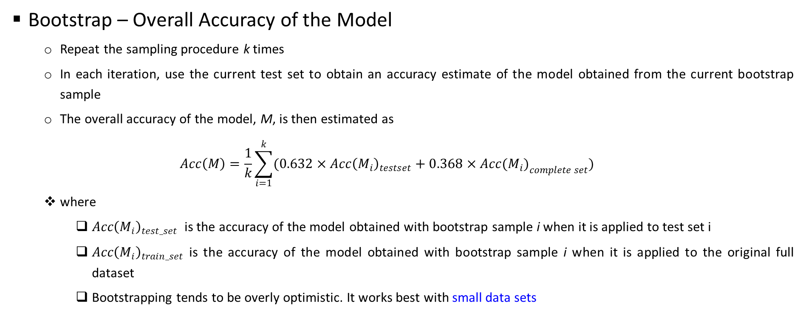
Selecting Training and Test Data
Data Selection Techniques
Bootstrap – Overall Accuracy of the Model
Repeat the sampling procedure k times
In each iteration, use the current test set to obtain an accuracy estimate of the model obtained from the current bootstrap sample
The overall accuracy of the model, M, is then estimated as
$$Acc\left(M\right)=\frac{1}{k}\sum_{i=1}^{k}{(0.632×{Acc\left(M_{i}\right)}_{testset}+0.368×{Acc(M_{i})}_{complete set})}$$
where
$Acc{\left(M_{i}\right)}_{test_set}$ is the accuracy of the model obtained with bootstrap sample i when it is applied to test set i
$Acc{\left(M_{i}\right)}_{train_set}$ is the accuracy of the model obtained with bootstrap sample i when it is applied to the original full dataset
Bootstrapping tends to be overly optimistic. It works best with small data sets
Source: Data Mining Concepts & Techniques by Han, Kamber, & Pei

Slide 28
ROC Curves

Slide 29
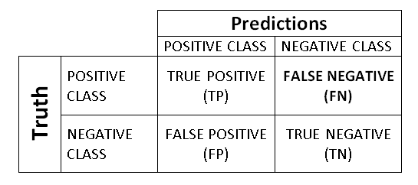
ROC Curves
History
Originated from signal detection theory
Applied in WW2 Battle of Britain to address:
Accurately identifying the signals on the radar scan to predict the outcome of interest – Enemy planes – when there were many extraneous signals (e.g. Geese)?
True Positives
Radar Operator interpreted signal as Enemy Planes and there were Enemy planes (Good Result: No wasted Resources)
True Negatives
Radar Operator said no planes and there were none (Good Result: No wasted resources)
False Positives
Radar Operator said planes, but there were none (Geese: wasted resources)
False Negatives
Radar Operator said no plane, but there were planes (Bombs dropped: very bad outcome)

Slide 30
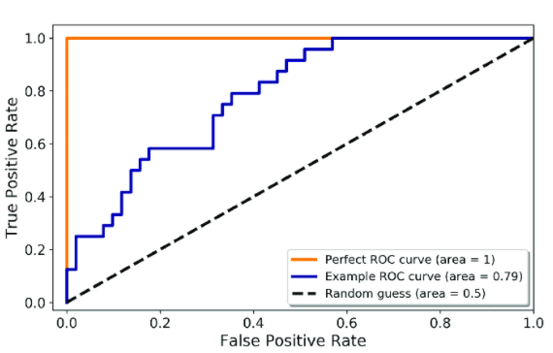
ROC Curves
Overview
ROC curves are a useful visual tool for comparing two binary classification models
Given TP, TN, FP, & FN
TPR is the proportion of positive (or "yes") tuples that are correctly labeled by the model
= TP/(TP+FN), which is sensitivity
FPR is the proportion of negative (or “no”) tuples that are mislabeled as positive
= FP/(FP+TN) , which is 1 − specificity
An ROC curve for a given model shows the trade-off between the true positive rate (TPR) and the false positive rate (FPR)
Source: Data Mining Concepts & Techniques by Han, Kamber, & Pei

Slide 31
ROC Curves
Optimal Probability Threshold
Consider an email classification model that detects suspicious communication between terrorists over regular email
Here, terrorist email is Class YES and a non-terrorist email is Class NO
It is absolutely necessary for the model to identify the terrorists’ emails correctly (True Positive Rate)
That is, we choose Sensitivity as a metric to improve this model because
the occurrence of false negatives is unacceptable
In this pursuit, we might end up having a few false positives/false alarms but that might be a compromise that we’ll have to make.
Let us say we develop 2 good models which have the same Sensitivity score
Does that mean the two models have equal predictive power? NO
Source: Analytics Vidhya - How to select Performance Metrics for Classification Models

Slide 32
ROC Curves
Optimal Probability Threshold
Most classification algorithms predict the probability that an observation belongs to class YES
We need to decide a threshold for these probabilities, to classify the observations into one of the two classes
The observation having probability higher than the threshold are classified as class YES.
For example:
the model predicts the probability of an email being a terrorist email as 0.75
If we set the threshold as 0.8, then we will classify this email as non-terrorist email
If we set the threshold as 0.7, then we will classify the email as a terrorist email
So, the performance of our system would vary as we change this threshold
This threshold can be adjusted to tune the behavior of the model for a specific problem
That is, we can reduce more of one or another type of error (FP/FN).
Source: Analytics Vidhya - How to select Performance Metrics for Classification Models

Slide 33
ROC Curves
Optimal Probability Threshold
Two models with the same sensitivity (TPR) are not equivalent
Among these two, the model with a lower FPR is obviously a better, more reliable model
We do not want to waste any of our investigative resources on non-terrorist emails that were misclassified as terrorist emails
The threshold that we set, can help us increase or decrease the TPR
If we choose a low threshold, more emails will be classified as terrorist emails, we will be able to catch more true positives but then even the false positive rate would increase
The choice of threshold entails a trade-off between false positives and false negatives.
An ROC curve is a useful resource in this regard.
Source: Analytics Vidhya - How to select Performance Metrics for Classification Models

Slide 34
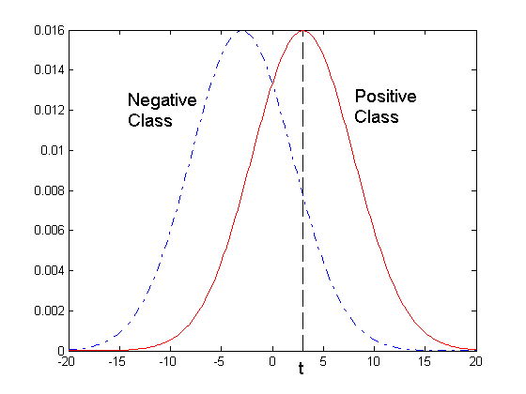
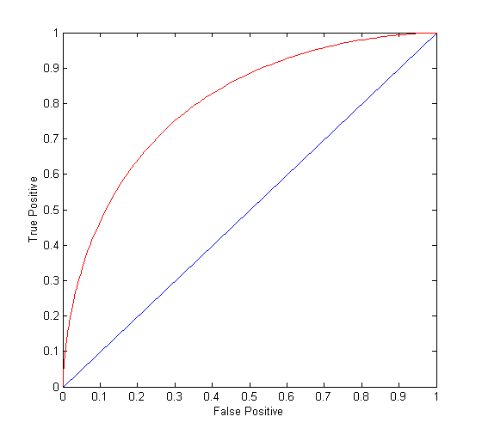
ROC Curves
Optimal Probability Threshold
1-dimensional data set containing 2 classes (positive and negative)
any points located at x > t is classified as positive
At threshold t:
TP=0.5, FN=0.5, FP=0.12, TN=0.88

Slide 35
4 | Linear Prediction Models: Linear Regression, Gradient Descent and Variants, Regularization, Bias Vs. Variance | T1: Chapter 4

Slide 36
Regression
Wish to learn a function f :: X → Y , where predicted output Y is real, given the n training instances {<x¹,y¹>…<x^{n},y^{n}>}.
For applications, where output will be a real value eg: Predicting housing price, predicting price of a stock market.
Examples include
predict weight from gender, height, age, …
Predict house price from locality, area, income, …
predict Google stock price today from Google, Yahoo, MSFT prices yesterday
predict each pixel intensity in robot’s current camera image, from previous image and previous action

Slide 37
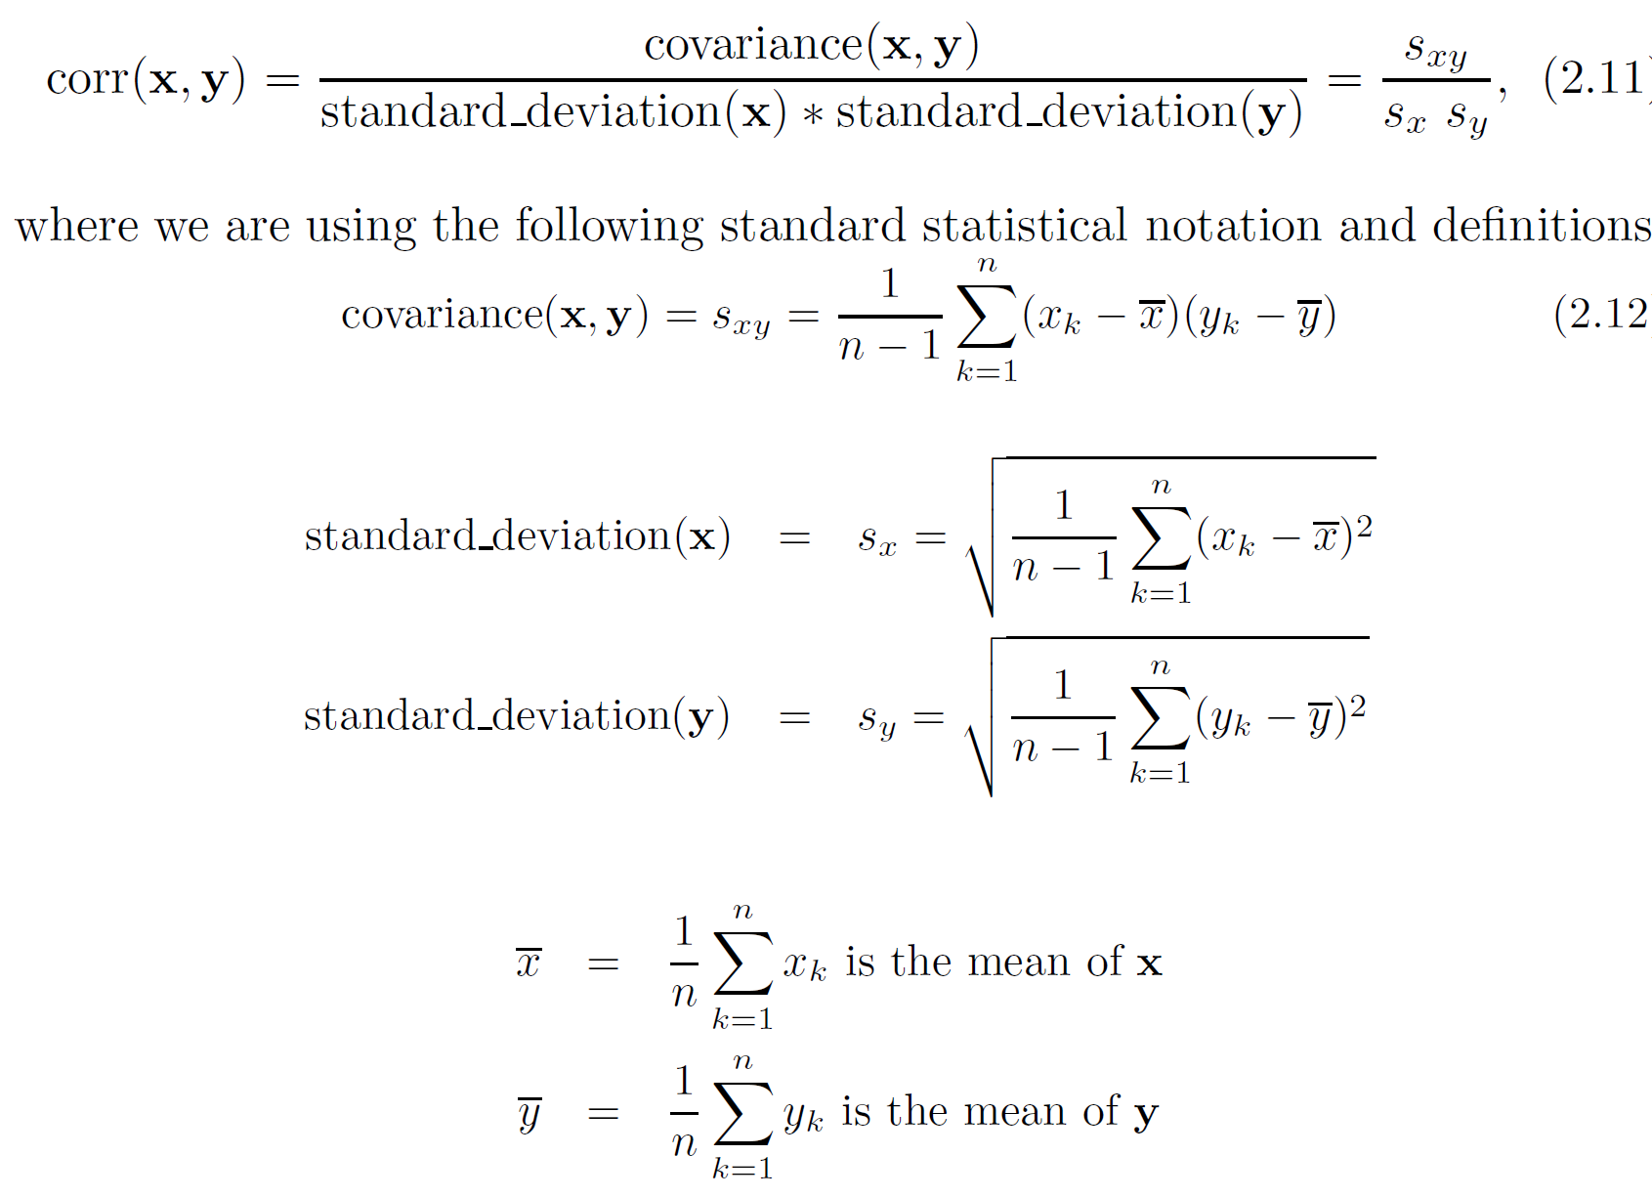
Correlation measures the linear relationship between objects

Slide 38
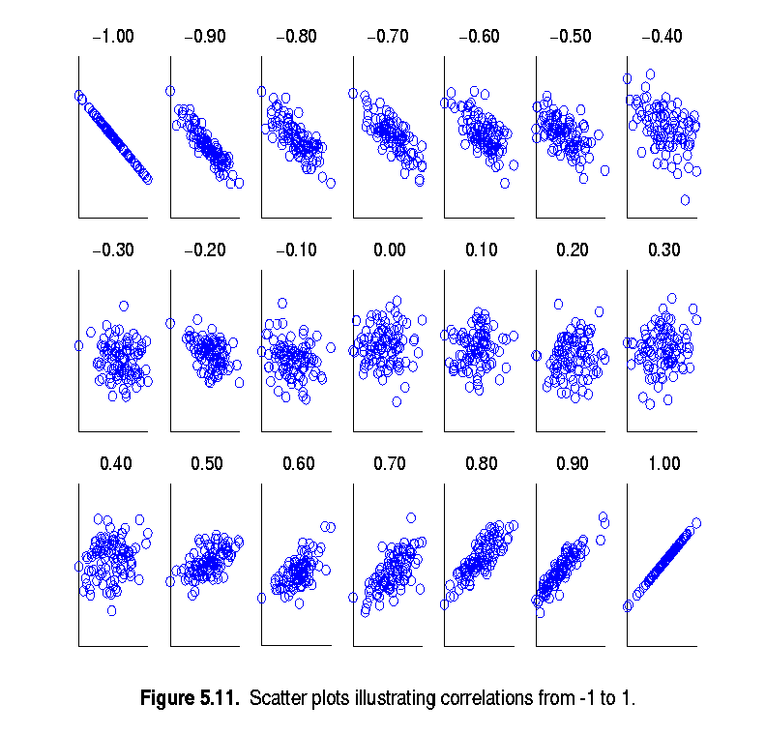
Visually Evaluating Correlation
Scatter plots showing the similarity from –1 to 1.

Slide 39
Two Approaches
Two very different ways to train it:
Using a direct “closed-form” equation that directly computes the model parameters that best fit the model to the training set (i.e., the model parameters that minimize the cost function over the training set).
Using an iterative optimization approach, called Gradient Descent (GD), that gradually tweaks the model parameters to minimize the cost function over the training set, eventually converging to the same set of parameters as the first method.

Slide 40
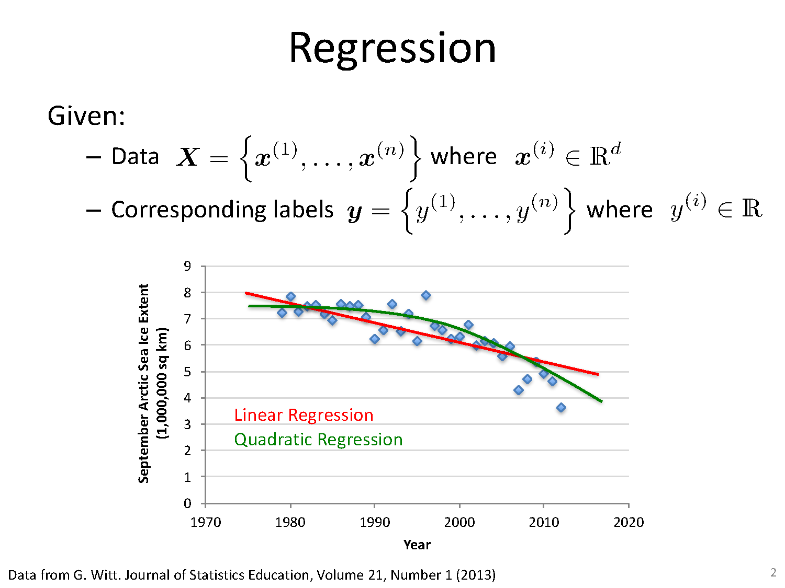
Least Squares Approach
N- no of samples
D: dimension
i- ith sample

Slide 41
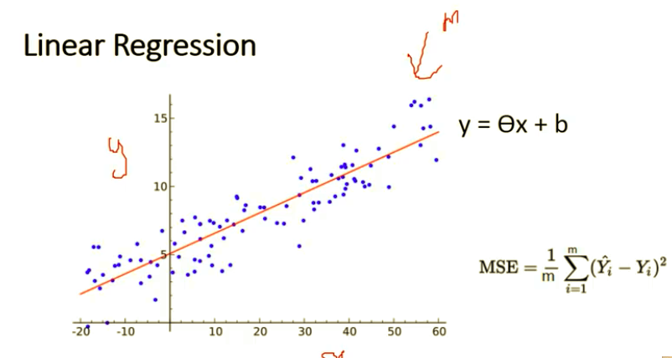
Least Squares Approach

Slide 42
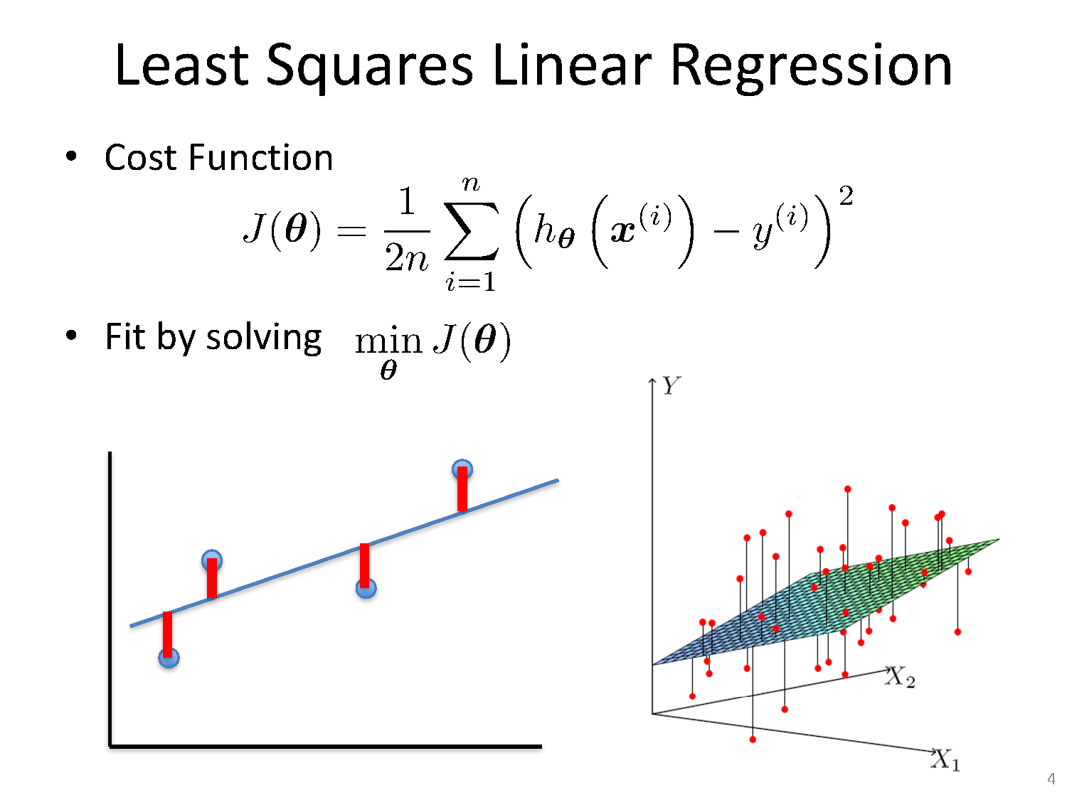
Least Squares Linear Regression

Slide 43
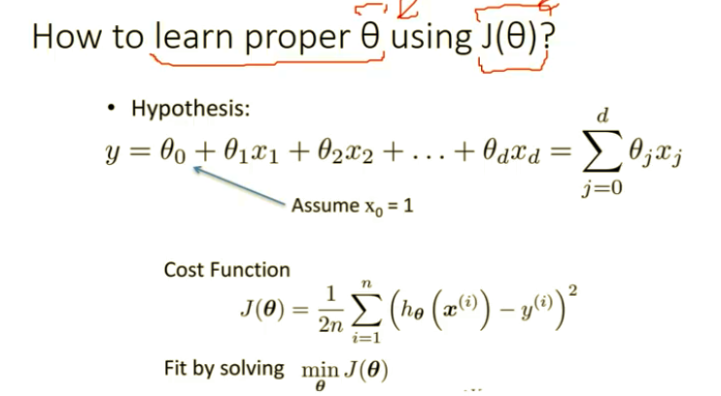
Least Squares Linear Regression
How to minimize J()

Slide 44
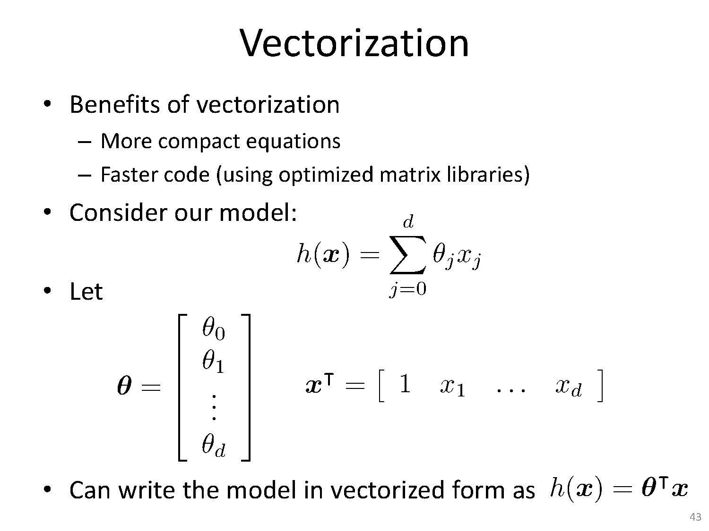
Least Squares Based Solution

Slide 45
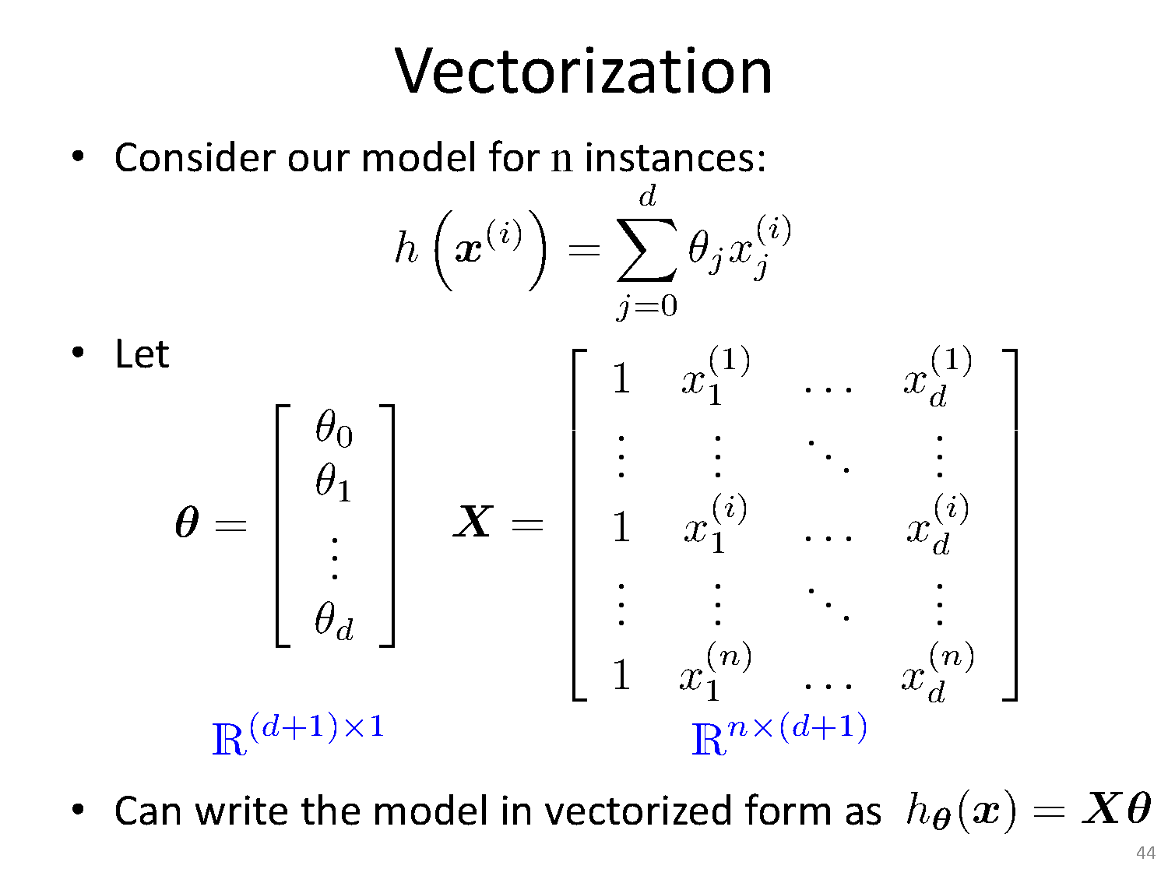
Least Squares Based Solution

Slide 46
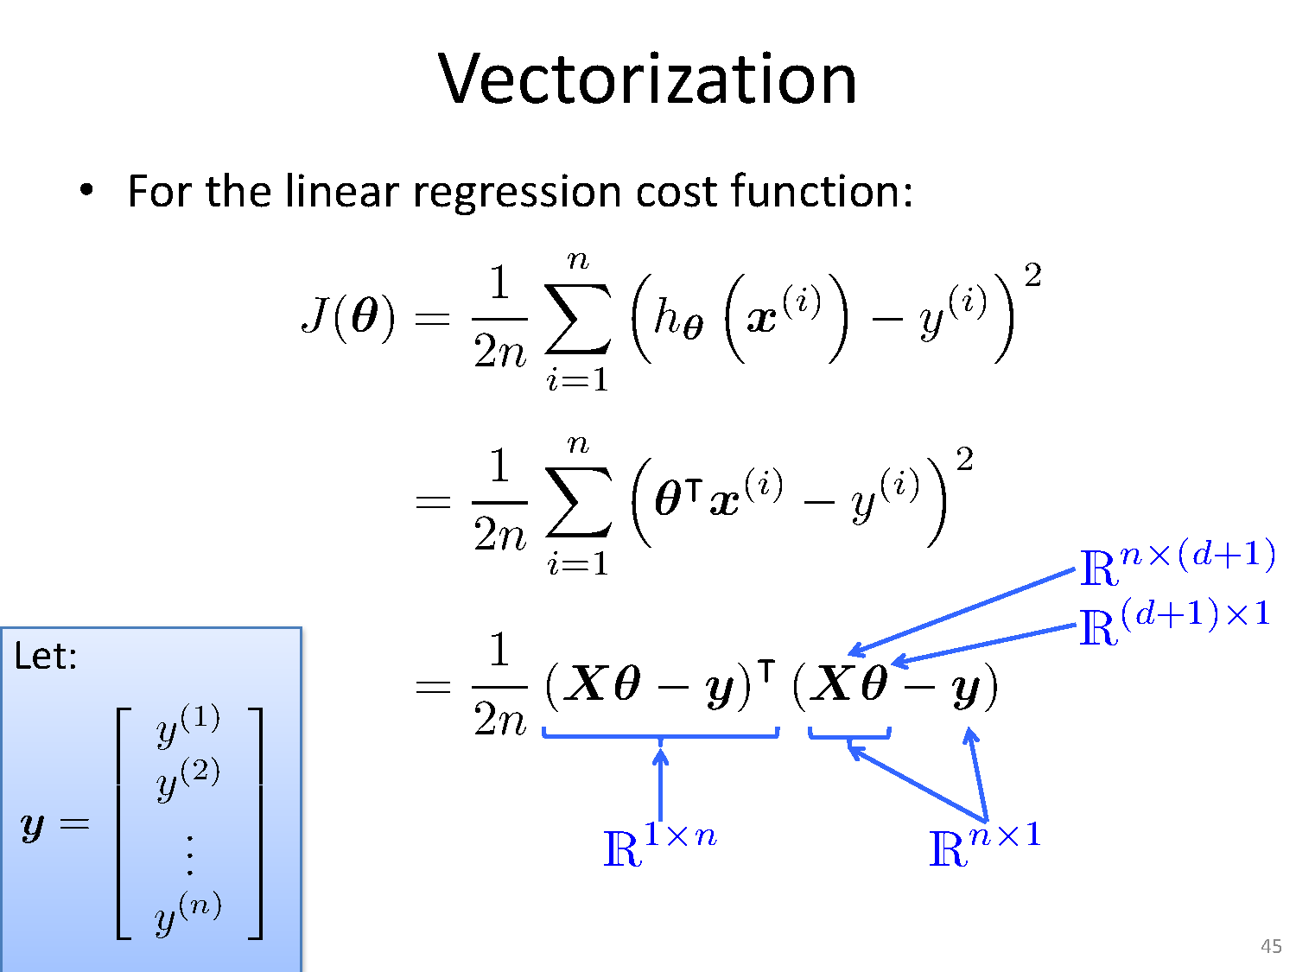
Least Squares Based Solution

Slide 47
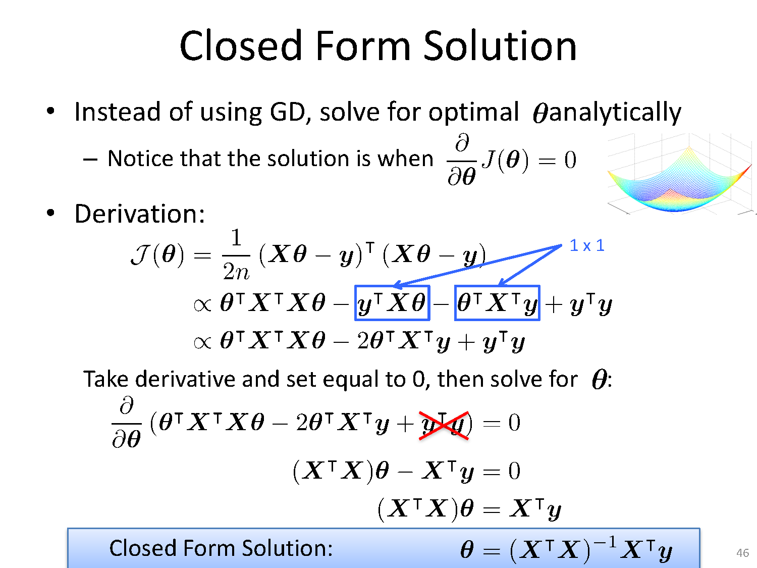
Least Squares Based Solution
Solve for optimal θ analytically

Slide 48
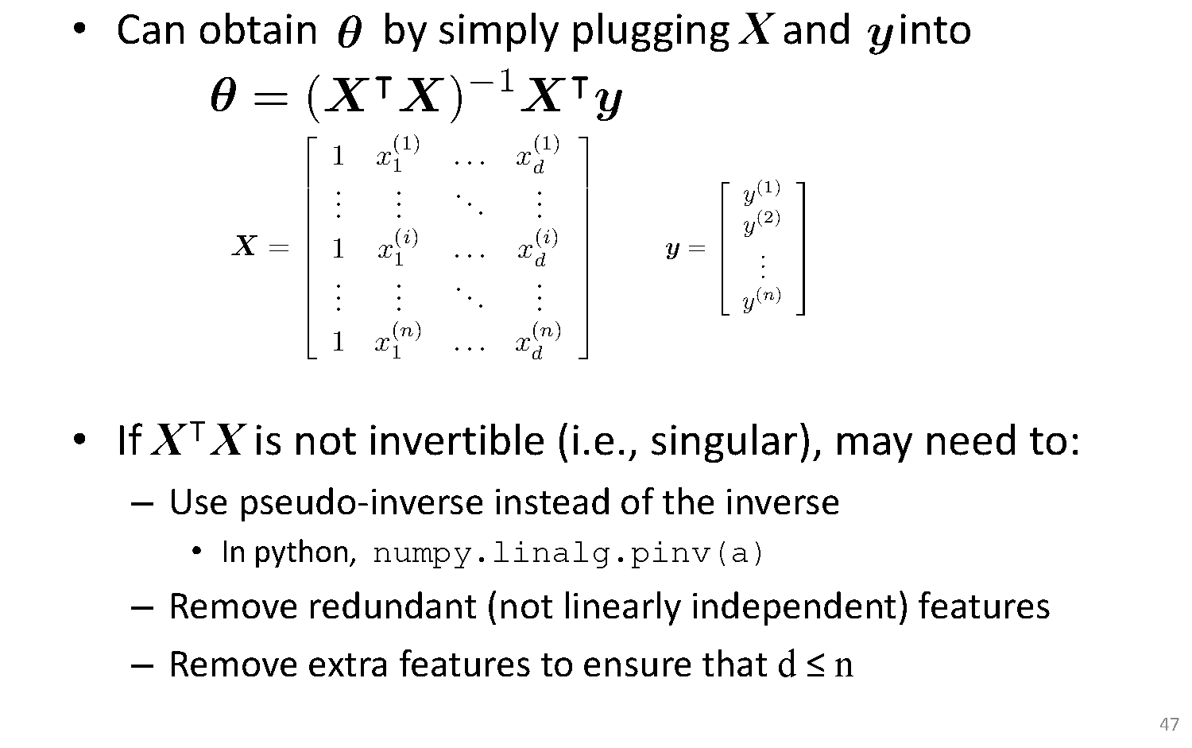
Least Squares Based Solution

Slide 49
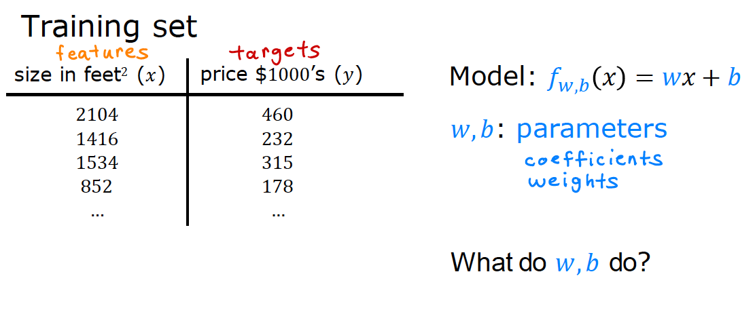
Intuition Behind Cost Function

Slide 50
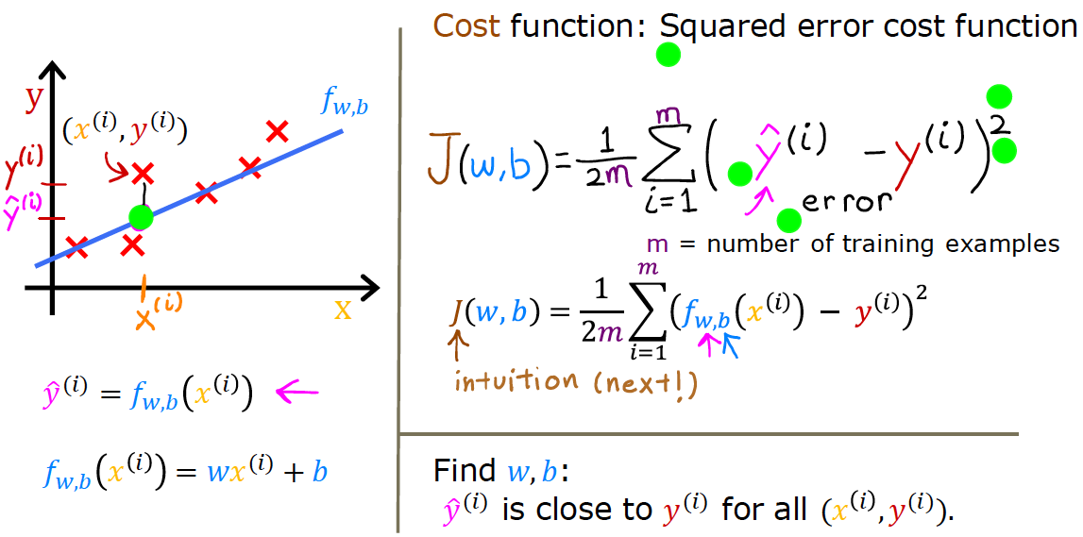
Intuition Behind Cost Function

Slide 51
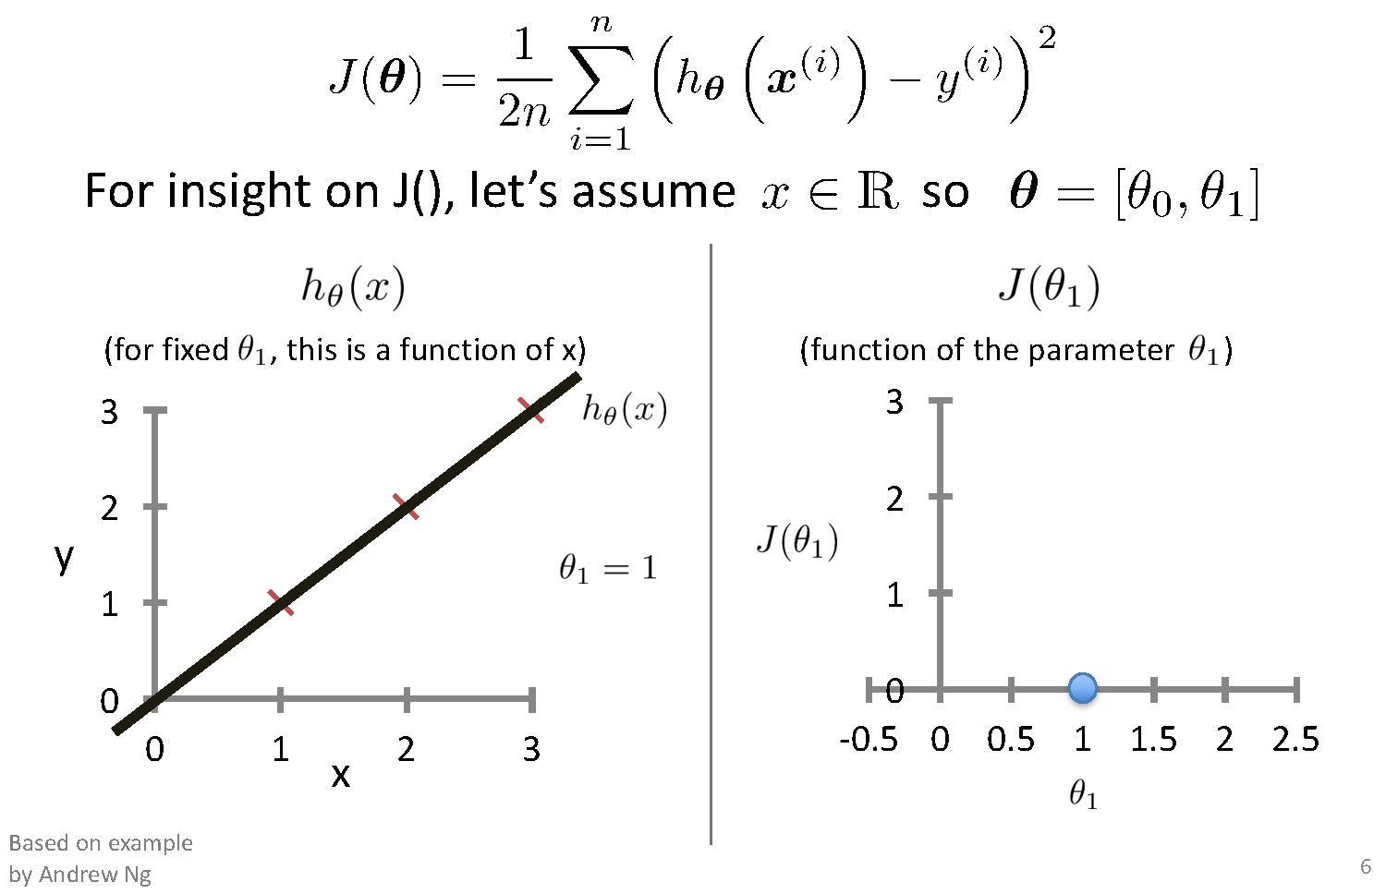
Intuition Behind Cost Function
Ɵ₀ =0

Slide 52
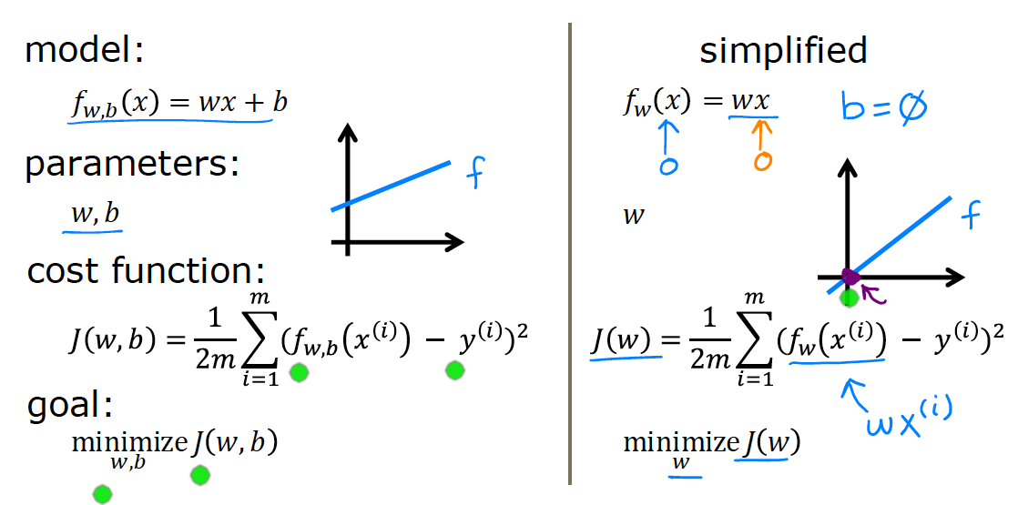
Intuition Behind Cost Function

Slide 53
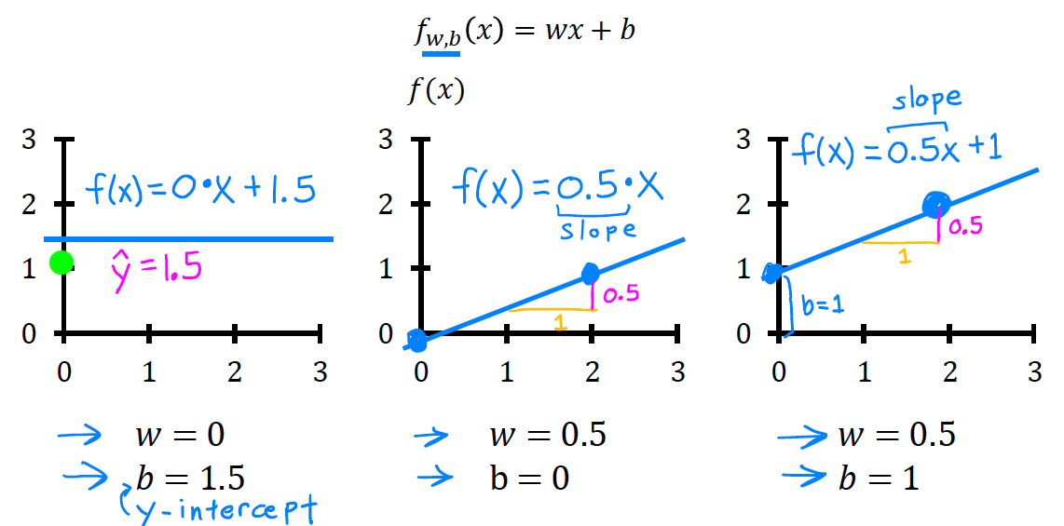
Intuition Behind Cost Function

Slide 54
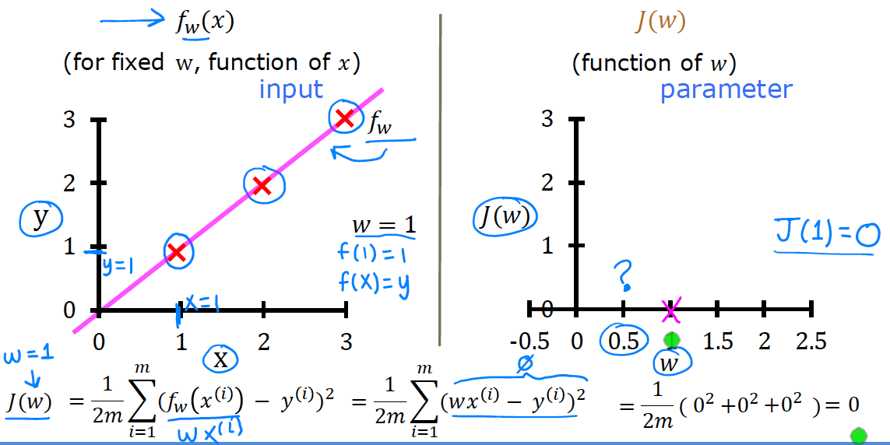
Intuition Behind Cost Function

Slide 55
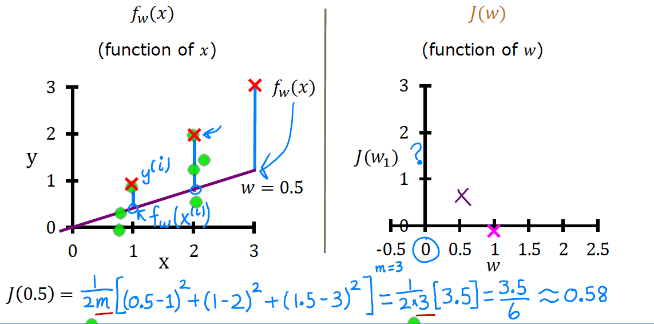
Intuition Behind Cost Function

Slide 56
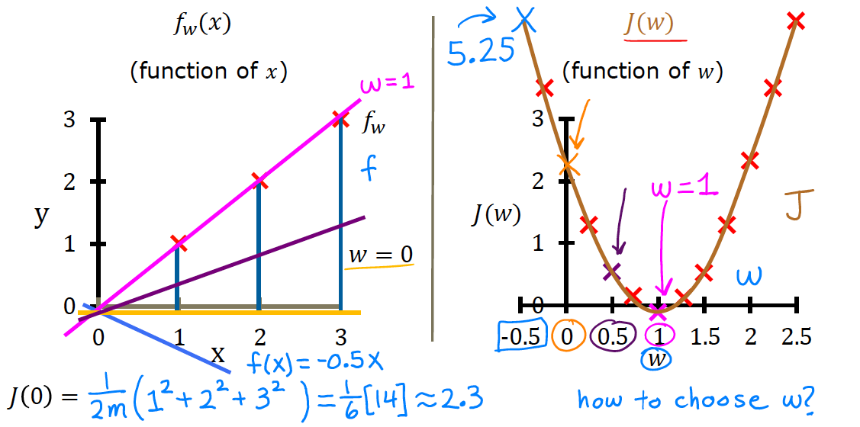
Intuition Behind Cost Function

Slide 57
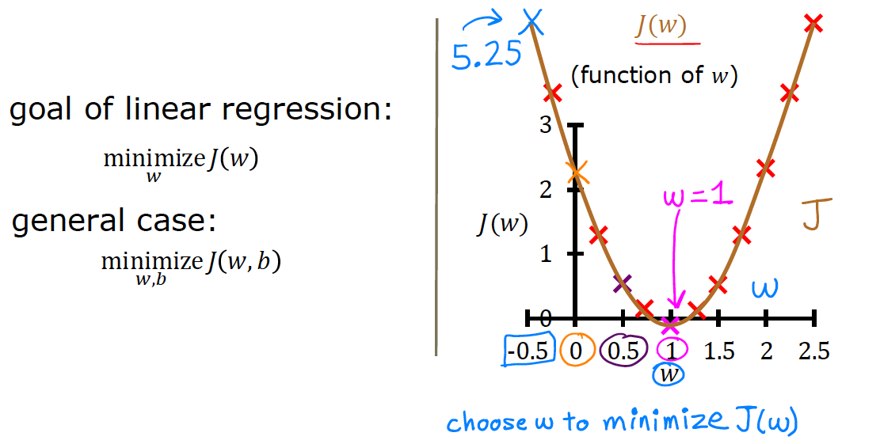
Intuition Behind Cost Function

Slide 58
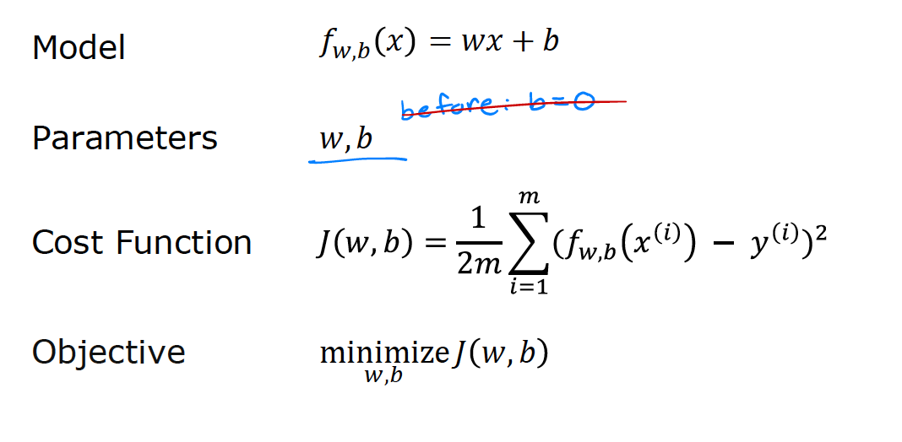
Intuition Behind Cost Function

Slide 59
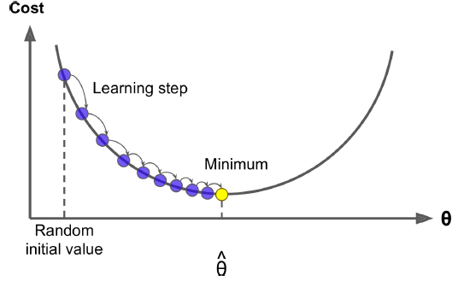
Gradient Descent
Gradient Descent is a very generic optimization algorithm capable of finding optimal solutions to a wide range of problems.
The general idea of Gradient Descent is to tweak parameters iteratively in order to minimize a cost function.
Concretely, you start by filling θ with random values (this is called random initialization), and then you improve it gradually, taking one baby step at a time, each step attempting to decrease the cost function (e.g., the MSE), until the algorithm converges to a minimum

Slide 60
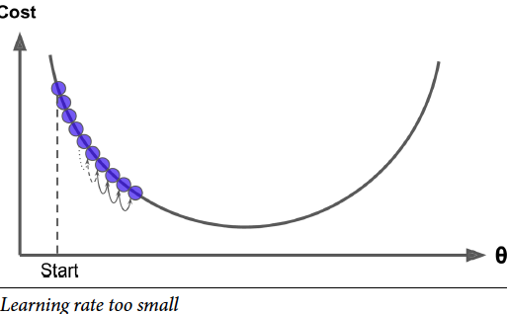
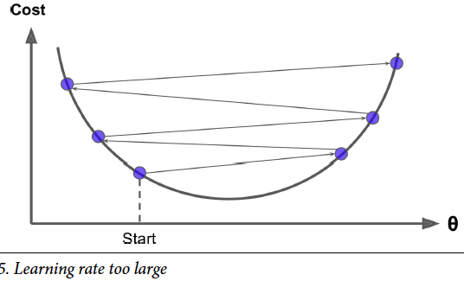
Gradient Descent- Hyper parameter
On the other hand, if the learning rate is too high, you might jump across the valley and end up on the other side, possibly even higher up than you were before. This might make the algorithm diverge, with larger and larger values, failing to find a good solution
If the learning rate is too small, then the algorithm
will have to go through many iterations to converge, which will take a long time

Slide 61
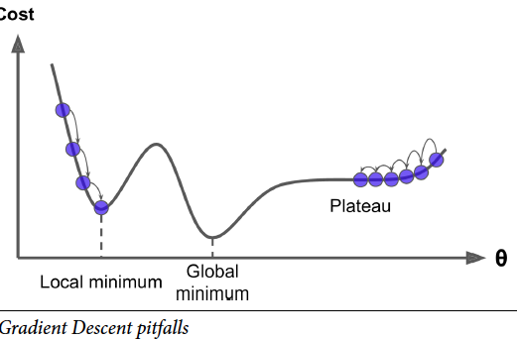
Gradient Descent- Pitfalls
Finally, not all cost functions look like nice regular bowls.
There may be holes, ridges,plateaus, and all sorts of irregular terrains, making convergence to the minimum very difficult.
Figure shows the two main challenges with Gradient Descent:
if the random initialization starts the algorithm on the left, then it will converge to a local minimum,which is not as good as the global minimum.
If it starts on the right, then it will take a very long time to cross the plateau, and if you stop too early you will never reach the global minimum.

Slide 62
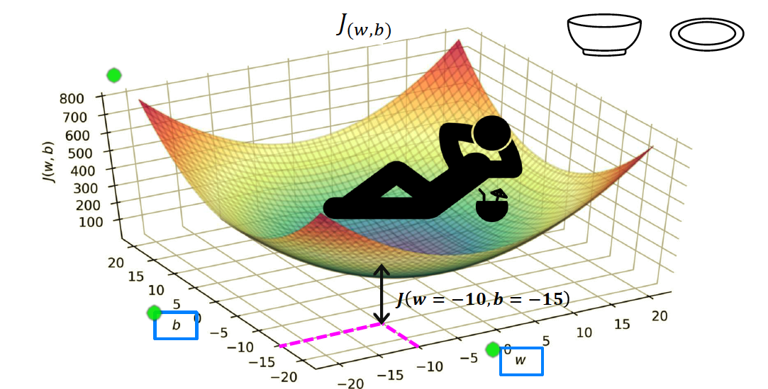
Intuition Behind Cost Function

Slide 63
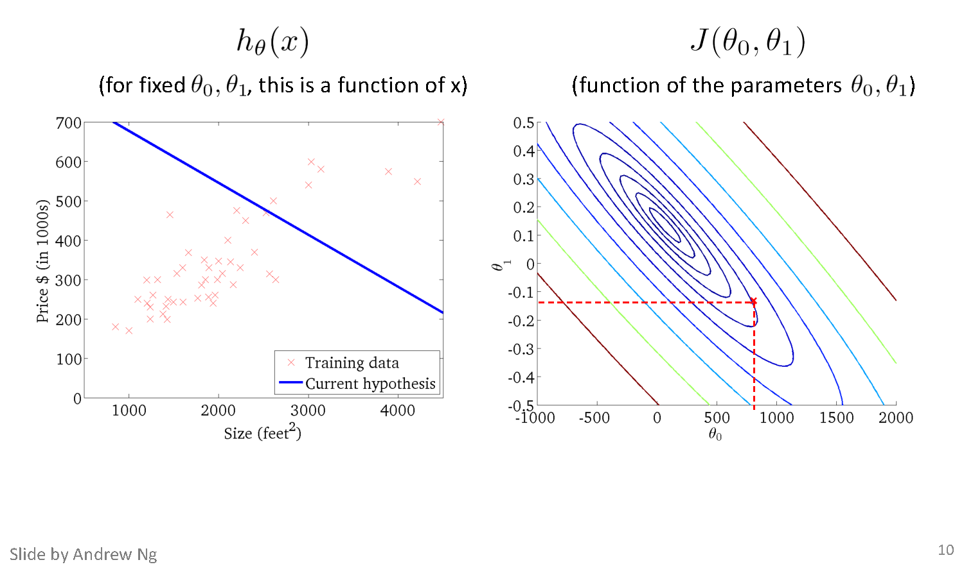
Intuition Behind Cost Function
(900,-0.1)
h(x)=900-0.1x

Slide 64
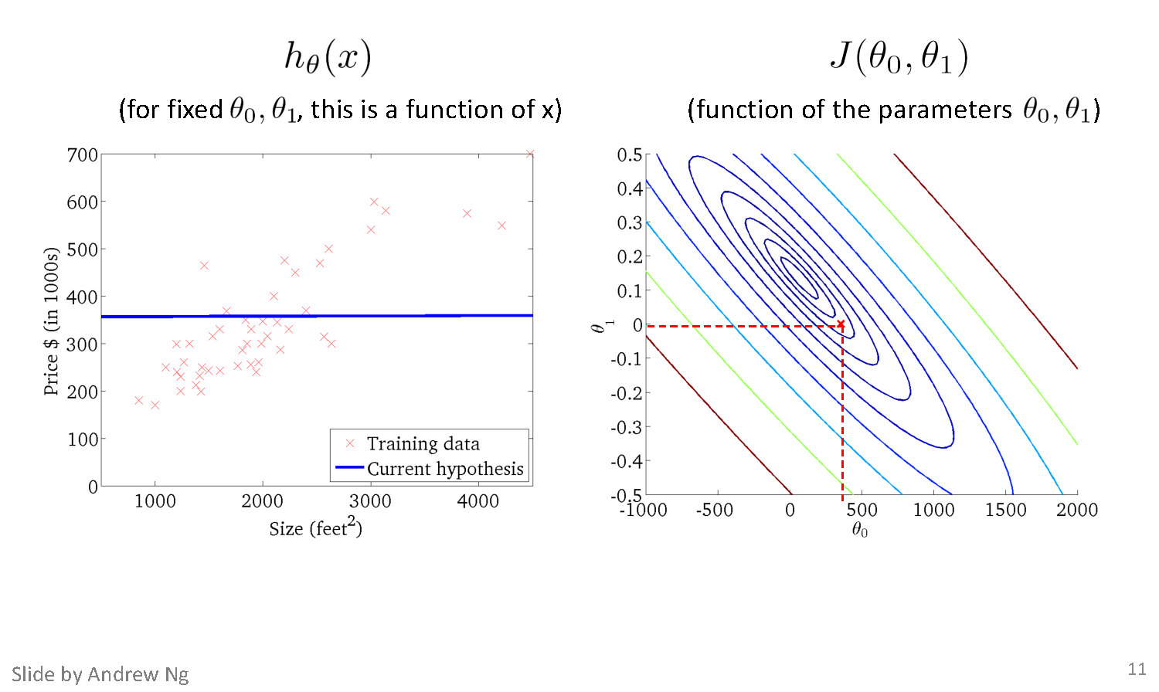
Intuition Behind Cost Function

Slide 65
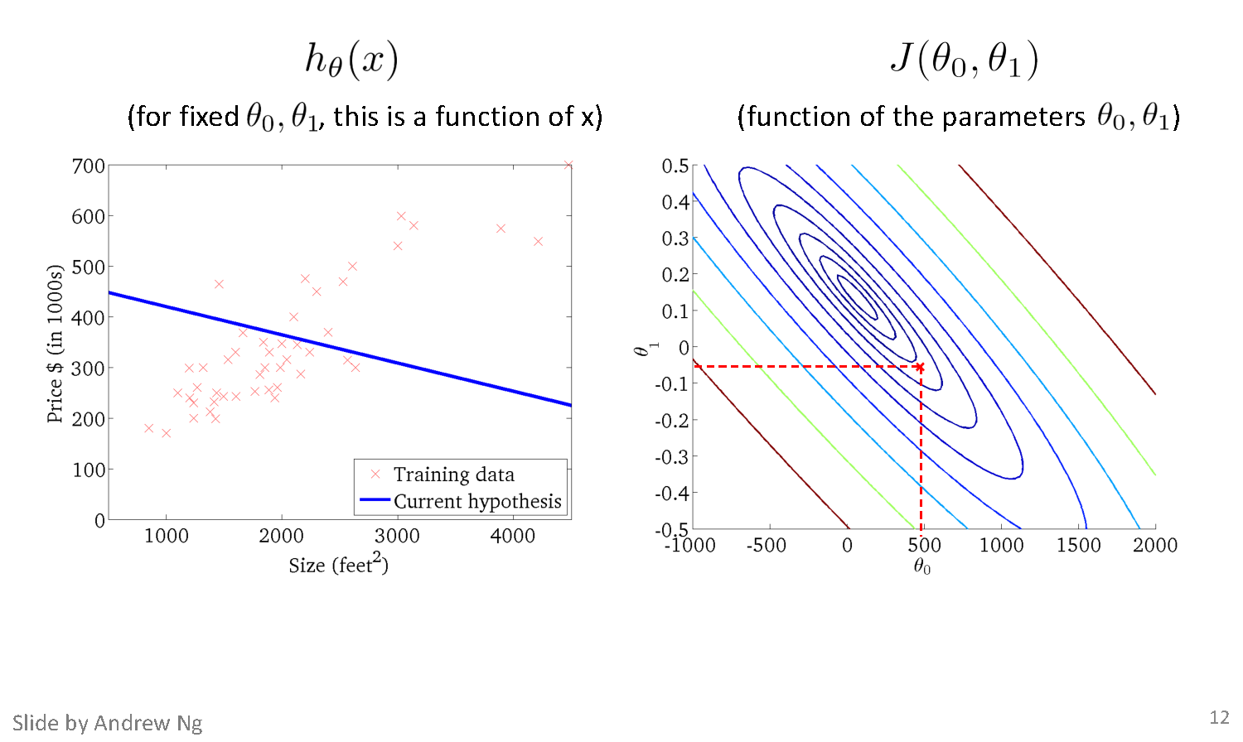
Intuition Behind Cost Function

Slide 66
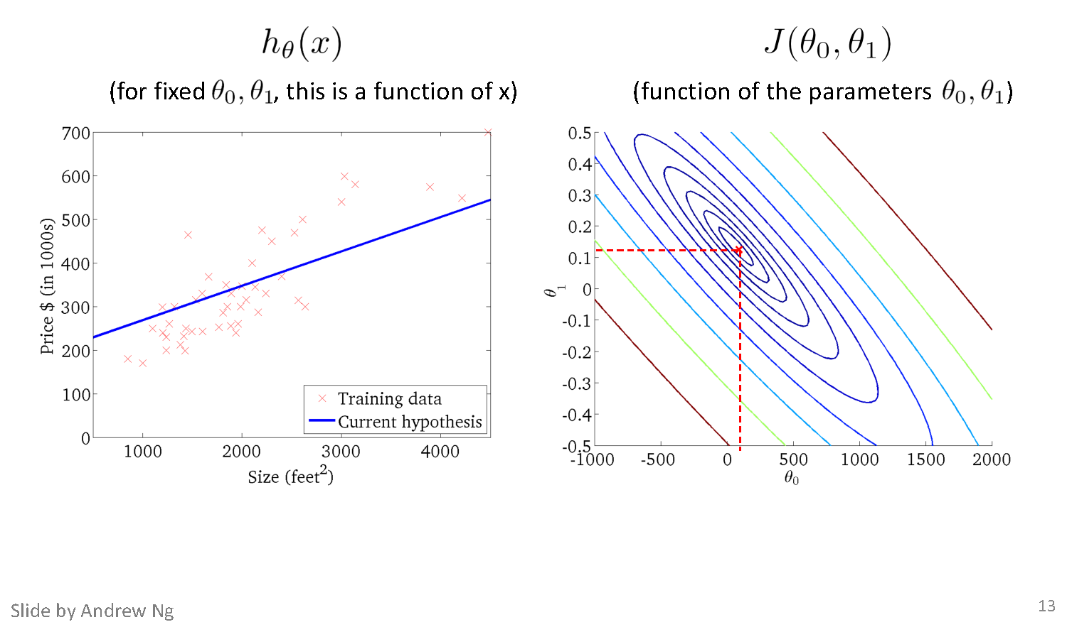
Intuition Behind Cost Function

Slide 67
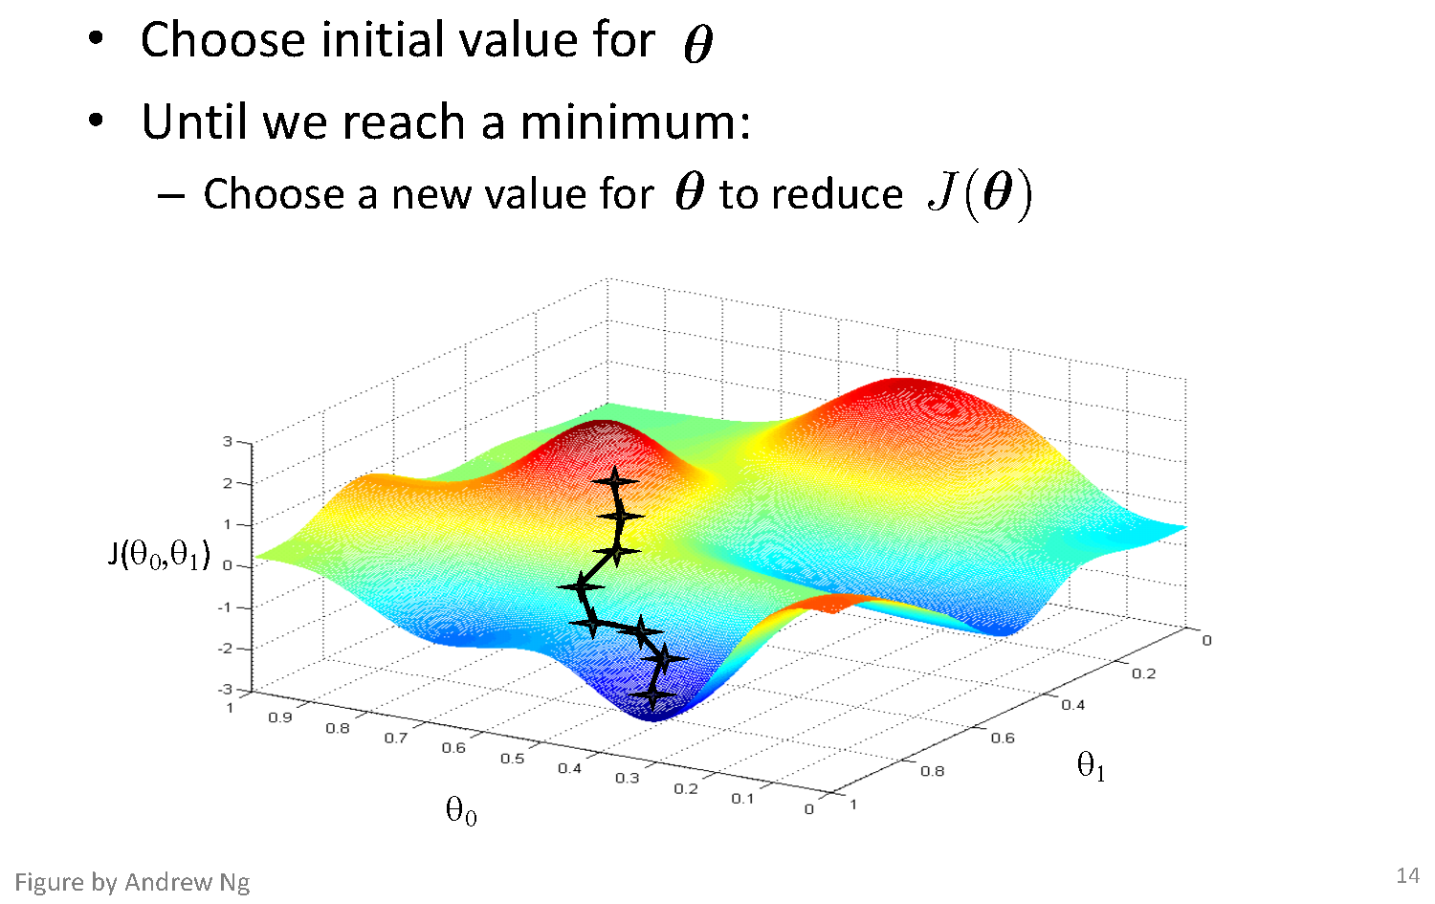
Basic Search Procedure

Slide 68
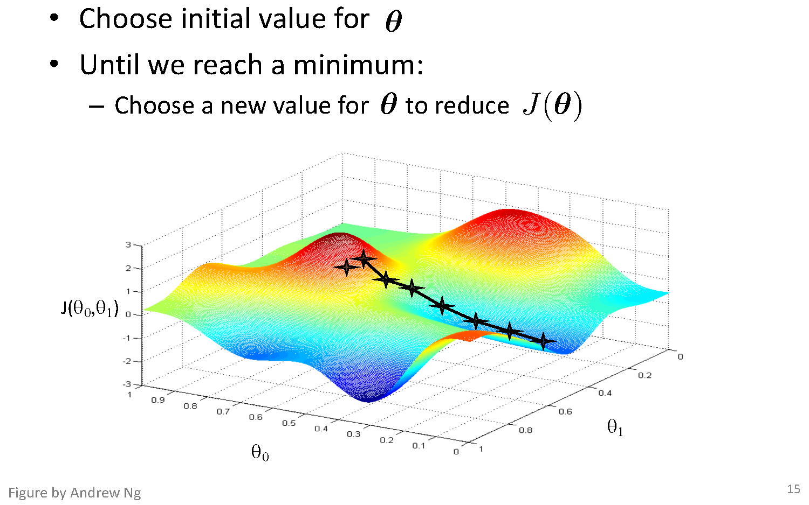
Basic Search Procedure

Slide 69
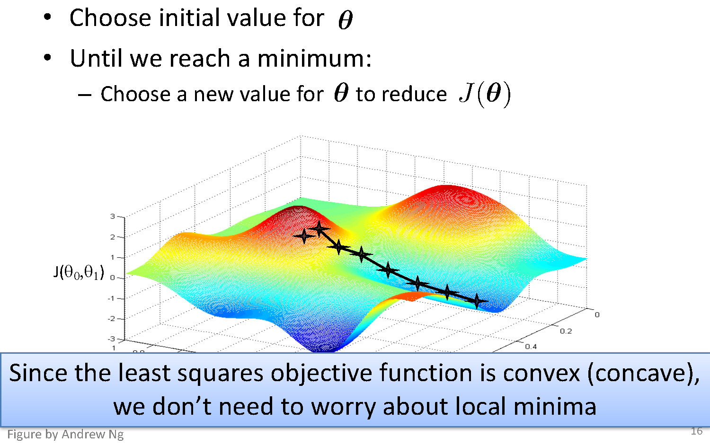
Basic Search Procedure

Slide 70

Gradient Descent

Slide 71

Gradient Descent

Slide 72

Gradient Descent for Linear Regression

Slide 73

Gradient Descent-Numerical Example

Slide 74
Gradient Descent-Numerical Example

Slide 75
Gradient Descent-Numerical Example

Slide 76

Gradient Descent

Slide 77

Gradient Descent

Slide 78

Gradient Descent

Slide 79

Gradient Descent

Slide 80

Gradient Descent

Slide 81

Gradient Descent

Slide 82

Gradient Descent

Slide 83

Running Gradient Descent

Slide 84

Running Gradient Descent

Slide 85

Running Gradient Descent

Slide 86

Running Gradient Descent

Slide 87

Running Gradient Descent

Slide 88

Running Gradient Descent

Slide 89
Running Gradient Descent

Slide 90

Running Gradient Descent

Slide 91

Running Gradient Descent

Slide 92

Running Gradient Descent

Slide 93

Choosing Step Size

Slide 94

Impact of Learning Rate
α=0.02
α=0.02
α=0.1
α=0.5

Slide 95

Feature Normalization
Gradient Descent can be slow when feature scales are widely different
Normalization of feature values for same variance needed for faster convergence

Slide 96

Impact Due To Batch Size
Choice of batch size impacts the rate of convergence of gradient descent (GD)
In Batch GD, entire training set is used to calculate the training error in each iteration/epoch and gradient is calculated and used for weight updates
Convergences in least number of iterations, i.e., rate of convergence is highest [O(1/iterations)]
Computation requirement per iteration is highest
Memory requirement is also highest
In Stochastic gradient descent, a randomly selected training instance is used
Convergences in highest number of iterations, i.e., rate of convergence is slowest [~O(1/$√iterations)]$
Computation requirement per iteration is lowest
Memory requirement is also lowest
In mini batch GD, a subset of training data of size, say 64,128, 256 is used
very efficient implementation possible leveraging vector processing using GPUs

Slide 97

Extending to More Complex Model

Slide 98


Fitting a Polynomial Curve

Slide 99

Quality of Fit

Slide 100
Addressing overfitting
$x_{1}=$ size of house
$x_{2}=$ no. of bedrooms
$x_{3}=$ no. of floors
$x_{4}=$age of house
$x_{5}=$average income in neighborhood
$x_{6}=$ kitchen size
$⋮$
$x_{100}$
Price ($) in 1000’s
Size in feet^2

Slide 101
Addressing overfitting
Reduce number of features.
Manually select which features to keep.
Model selection algorithm
Regularization.
Keep all the features, but reduce magnitude/values of parameters $θ_{j}$.
Works well when we have a lot of features, each/many of which contributes a bit to predicting $y$.

Slide 102


Effect of Training Size on Overfitting
Size of training dataset needs to be large to prevent overfitting
when higher order model is used.
Higher order model
Lower order model

Slide 103

Polynomial Fitting can lead to Overfitting
Underlying target function is quadratic
Linear model results in underfitting with large bias
Polynomial of order 300 results in a large variance

Slide 104

Regularization

Slide 105

Ridge Regularization

Slide 106

Understanding Regularization

Slide 107


Understanding Regularization
Overfitting

Slide 108


Understanding Regularization
Underfitting

Slide 109

Ridge regression
Regularized Linear Regression

Slide 110

Ridge Regression
Further simplified

Slide 111


Lasso Regularization

Slide 112


Ridge Vs Lasso Regularization
λ = 0
λ = 0
λ = 10
λ = 10⁻⁵
λ = 100
λ = 1
Lasso
λ = 0
λ = 0
λ = 0.1
λ = 10⁻⁷
λ = 1
λ = 1
λ
Ridge

Slide 113

Early Stopping
Do Not Over train to prevent overfitting
Stop training once error on the validation set starts showing an upward trend, even if the error on the training set keeps decreasing

Slide 114

Bias Variance Tradeoff
Bias/Variance is a Way to Understand Overfitting and Underfitting

Slide 115

Bias and Variance

Slide 116

Bias and Variance

Slide 117

Bias and Variance

Slide 118

Bias and Variance

Slide 119

Bias and Variance

Slide 120

Bias and Variance

Slide 121
Thank You!
In our next session: Classification Models

